Slide 1
A Seminar on SmartQuiz: AI MCQ Generation
Team Details
Garlapati Akshay Reddy [20EG105314]
Lakshmishetty Nikhil Shetty [20EG105325]
Ramankol Srikanth [20EG105343]
Project Supervisor
P.Chakradhar
Assistant Professor

Slide 2
Introduction
Automated question generation is an innovative field within natural language processing (NLP) that leverages advanced machine learning techniques to automatically formulate questions from given textual content. This process involves understanding the context and extracting key information to generate meaningful and contextually relevant questions. To implement automated question generation, a combination of summarization, language modeling, and fine-tuning methodologies is typically employed.
To embark on automated question generation, certain prerequisites are essential. These include a comprehensive dataset for training and fine-tuning models, a robust NLP framework, and access to pre-trained language models capable of understanding and processing contextual information. Additionally, an understanding of the target domain and the specific requirements for generating questions is crucial for effective implementation.

Slide 3
Introduction
The applications of automated question generation are diverse and impactful.
Education:
Automated question generation for educational materials.
Efficient creation of quizzes and exams for various subjects and levels.
Adaptive learning platforms for personalized assessments.
Training and Evaluation:
Enhancing the efficiency of training programs by automating the creation of evaluation materials.
Providing a tool for organizations to assess the knowledge and understanding of their workforce.

Slide 4
Problem Statement
The project aims to enhance the efficiency of content summarization, keyword extraction, question generation, and distractor generation through the integration of advanced natural language processing techniques. By employing state-of-the-art models and algorithms, the system streamlines the information extraction process, facilitating better comprehension and utilization of textual content.
Current approaches lack precision, struggle with diverse content, and may produce suboptimal results. The project addresses these issues by employing modern NLP models for improved language understanding.
The project tackles information overload, aiming to provide accurate and concise content summaries, relevant keywords, and meaningful questions. It addresses the limitations of conventional methods in handling the increasing volume of textual data.

Slide 5
Proposed Method
Load The text:
Get the text from the user.
Text Summarization:
Perform summarization on the given text to condense the information and capture key points.
Keyword Extraction:
Utilize keyword extraction methods Python key phrase extraction algorithm(PKE) to identify important terms from the summarised text.
Question Generation:
Generate questions based on the extracted keywords by using a fine-tuned question generation model (T5 model trained on Squad-V1 dataset , EduQG and C Language datasets).

Slide 6
Formulate questions in a context-answer format, incorporating the keywords and relevant information from the processed text.
Distractor Generation:
Generate distractors (wrong answer choices) using method like Sense2Vec,genai and finding sense of it.
Ensure that distractors are contextually relevant but distinct from the correct answer.
Display Results:
Present the generated questions along with answer choices (including the correct answer and distractors) for assessment.

Slide 7
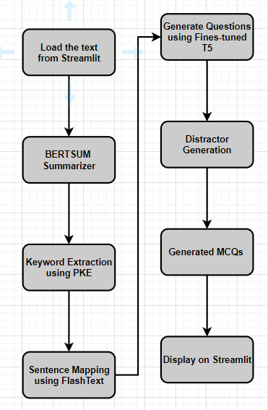
Proposed Method

Slide 8
Experiment Environment
Machine Specifications:
Processor: Intel Core i5
Memory (RAM): 32GB RAM
Storage: 1 TB HDD
Operating System: Windows OS
Execution Environment:
Google Colab: Utilized for fine-tuning T5 for question generation.
Anaconda: Deployed for MCQ generation.
Deployment:
Streamlit: Used for deploying the MCQ generation application, providing a user-friendly interface for interaction.

Slide 9
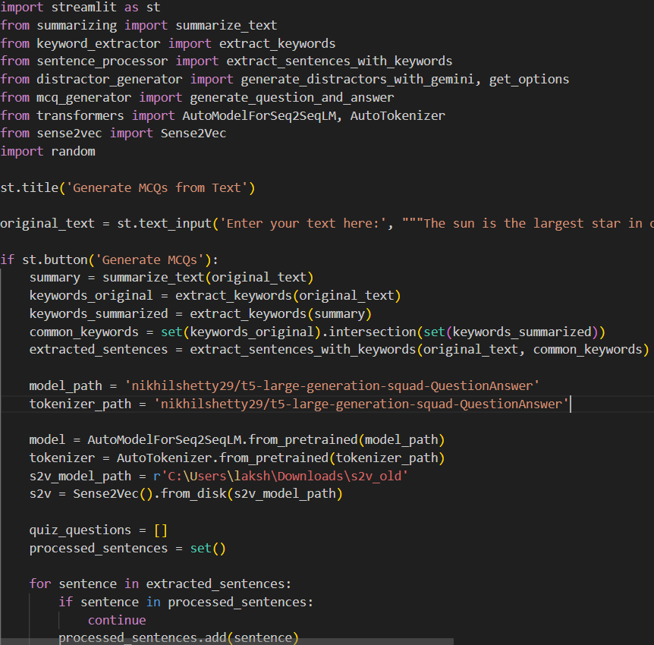
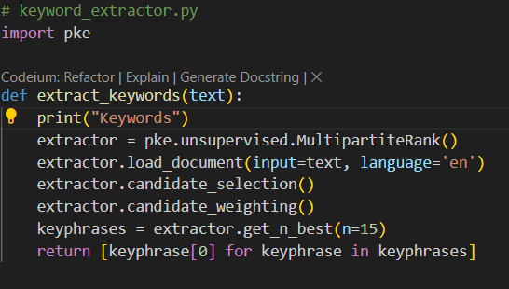
Experiment Screenshots

Slide 10
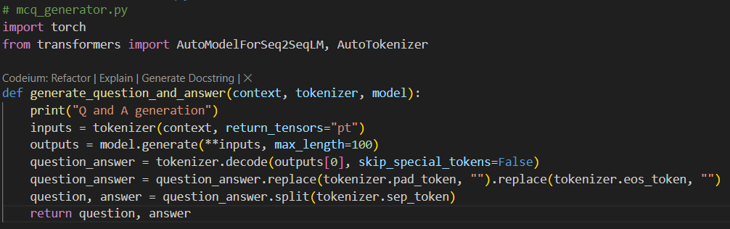
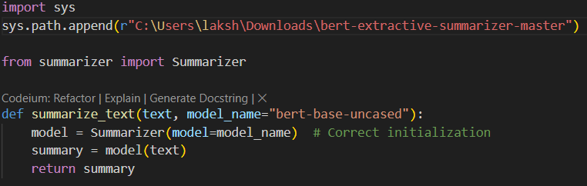

Slide 11
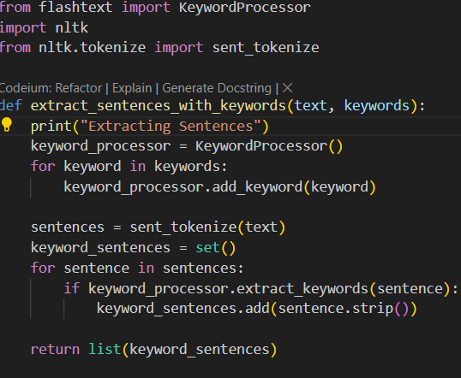

Slide 12

Experiment Results

Slide 13
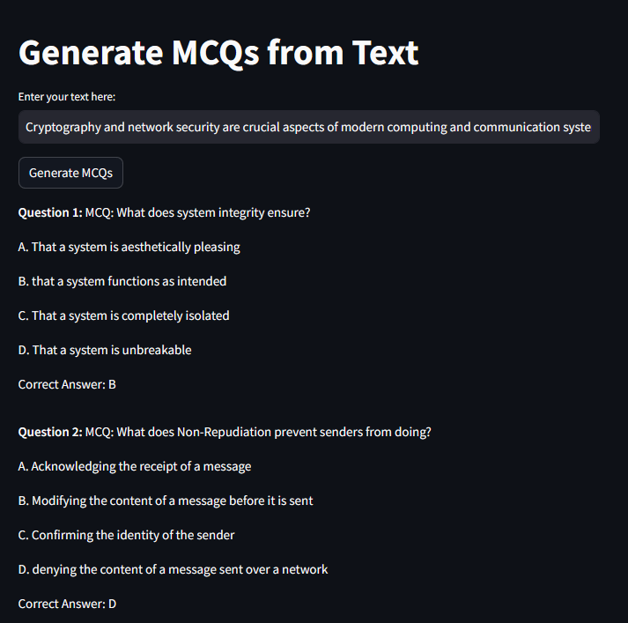
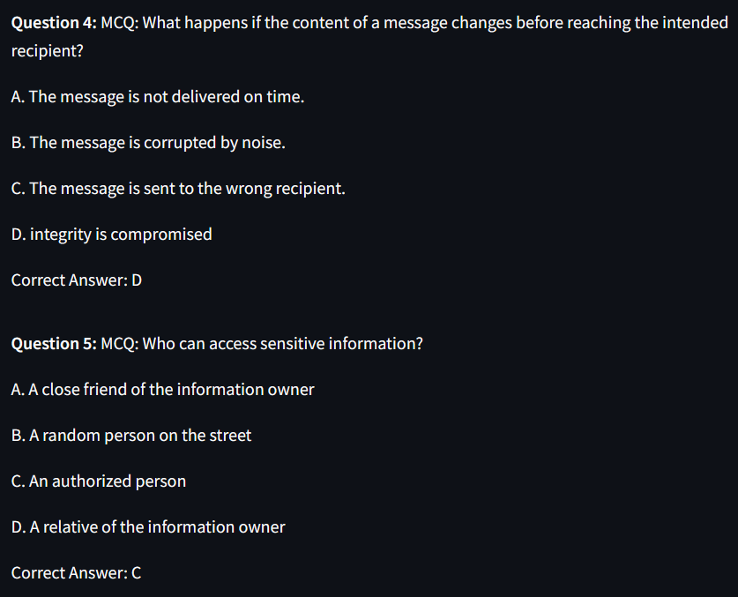
Experiment Results

Slide 14
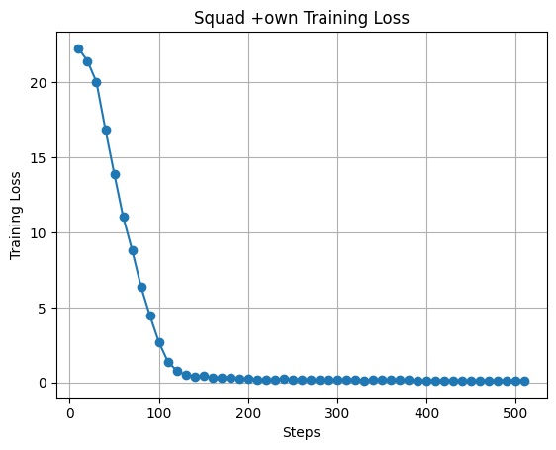
Finding
Experiment 1: The training loss graph for the T5 model displays a typical learning curve, indicating effective learning from the SQuAD and C language question datasets. While the sharp decline in loss values reflects initial learning, the plateau phase suggests convergence to optimal parameters, highlighting the model's efficiency. However, it's crucial to monitor for overfitting during this phase to maintain generalization ability. In experiment 1 (SQuAD + C dataset), the model demonstrates commendable abilities in generating general questions, but the training loss curve hints at potential challenges in capturing the nuances of C programming. Despite this, the model excels in producing questions that align perfectly with human-written ones, particularly within the context of C programming. This suggests a strong proficiency in specific domains despite potential limitations in broader question generation. | Training loss values graph fine tuning t5 on SQUAD and C language datasets

Slide 15
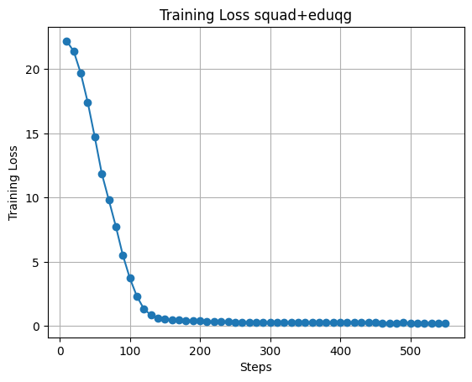
Finding
Experiment 2: Findings: The model's proficiency in general question generation, as evidenced by a potentially lower final loss value in the training phase. However, there are indications of limitations in generating C-specific questions, as suggested by potentially lower Exact Match, F1 scores, especially for less complex questions. While the model excels in generating questions across various topics, it may require further refinement to cater specifically to C programming. | Training loss values graph fine tuning t5 on SQUAD and EduQG datasets

Slide 16
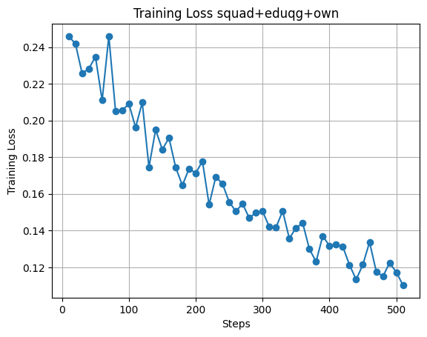
Finding
Experiment 3: Findings: This graph represents a well-balanced approach, showcasing strong capabilities in both general question generation and C programming-specific question generation. The training loss curve demonstrates effective learning across diverse topics, including C programming. Additionally, the model maintains robust Exact Match, F1 scores, potentially comparable to or slightly lower than those in experiment 1, indicating a high level of proficiency in generating questions that precisely match human-written ones. Overall, experiment 3 emerges as the optimal choice, striking a fine balance between general question generation and competency in C programming question generation. | Training loss values graph fine tuning t5 on SQUAD , C language and EduQG datasets

Slide 17
Justification
Parameters Improved by Our Method:
Our method has significantly improved several key parameters, leading to more efficient question generation:
Increased AVG F1 Score: We achieved a notable increase in the Average F1 Score, rising from 53.89 to 69.18. This improvement demonstrates a better balance between precision and recall in the generated questions.
Improved Meteor Score: Our method has substantially enhanced the Meteor Score from 0.5094 to 0.64, indicating a significant improvement in the linguistic similarity and coherence between the generated questions and reference questions.
Enhanced Average Exact Match: There has been a remarkable enhancement in the Average Exact Match, improving from 3.23 to 11.29. This improvement underscores the efficiency and accuracy of our approach in generating questions that exactly match the reference questions.
Enhanced Rouge-l sum Score: Our method achieved a substantial increase in the Rouge-lsum Score from 51.8 to 66.3, indicating a significant improvement in the overlap and relevance of the generated questions with the reference questions.
Overall, these improvements highlight the effectiveness of our method in producing more accurate, relevant, and efficient questions across various evaluation metrics.

Slide 18
Mathematical formulas for calculating parameter values:
F1 Score: F1 score can be calculated based on the presence of generated questions in the set of reference questions, considering precision and recall.
F1 = 2 * (Precision * Recall) / (Precision + Recall)
Precision: Precision = (Number of Generated Questions in Reference) /
(Total Number of Generated Questions)
Recall: Recall = (Number of Generated Questions in Reference) / (Total Number of Reference Questions)
Exact Match: Exact Match evaluates whether the generated question exactly matches any of the reference questions:
Exact Match = (Number of Exact Matches) /
(Total Number of Generated Questions)
METEOR (Metric for Evaluation of Translation with Explicit ORdering):
METEOR considers various linguistic aspects such as fluency, precision, and recall:
METEOR = (10 * P * R) / ((1 - alpha) * R + alpha * P) * (1 - beta * e^(-L / L0))

Slide 19
Reasons for Improved Parameter Values:
Expanded Dataset: By incorporating additional datasets such as SQuAD, EduQG, and a C programming-specific dataset, our model gains a broader understanding of various question types and contexts, leading to improved performance across different domains.
Model Architecture: Utilizing the T5 Transformer model, which is known for its versatility and strong performance in natural language processing tasks, contributes to enhanced question generation capabilities. Additionally, leveraging techniques such as Bertsum for summarization may aid in distilling key information and generating more accurate questions.
Fine-Tuning and Training: Fine-tuning the T5 model on a diverse dataset enables it to adapt specifically to the task of question generation, resulting in improved accuracy and relevance of generated questions. Additionally, optimizing training parameters and strategies may further enhance the model's performance on both general and domain-specific question generation tasks.

Slide 20
Thank You

